Slide 1

Members:
• Anmol Patodia
• Riyan Baruah
• Biddipta Kashyap
• Abhishu Baruah

Slide 2
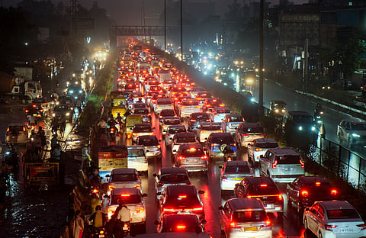
Traffic Jam Management

Slide 3
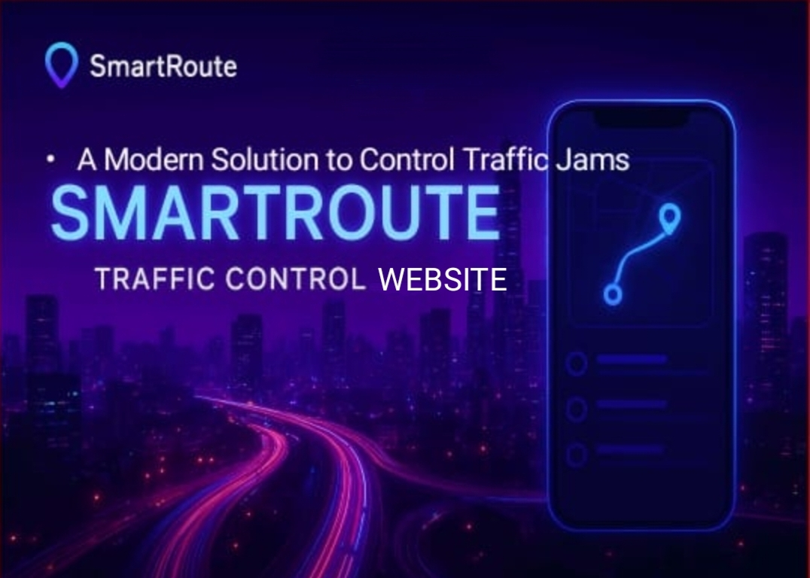

Slide 4


Used software
HTML

Slide 5
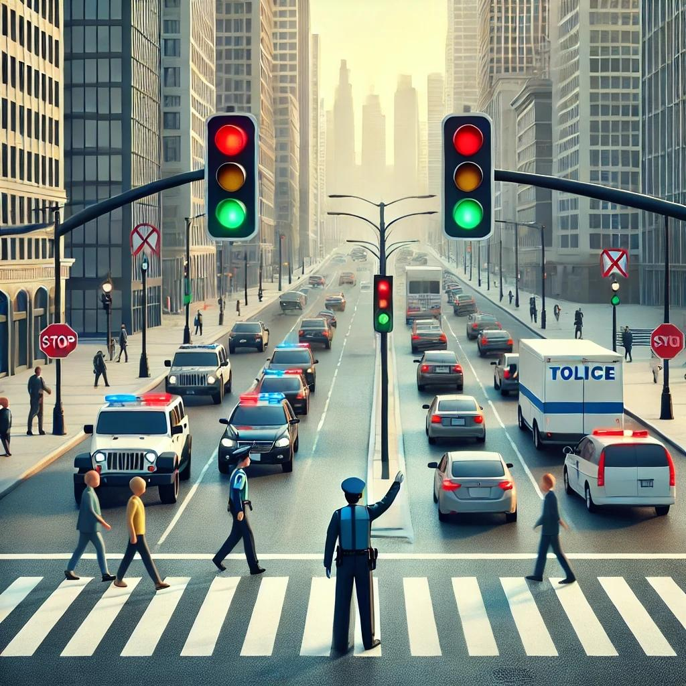
Contents
Introduction
What is Traffic
How it harms us a affects our daily life
What we want to solve
About our Website
How it will help and work
Who will it help
Final impact in a long run
Stability and scalability
Things which we could fulfill and things We were not able to fulfill
Trial and errors
Conclusion

Slide 6
Introduction
Traffic jam management is the practice of controlling and reducing congestion on roads to ensure smooth and safe vehicle movement. It helps save time, reduce fuel use, and make travel easier for everyone.

Slide 7
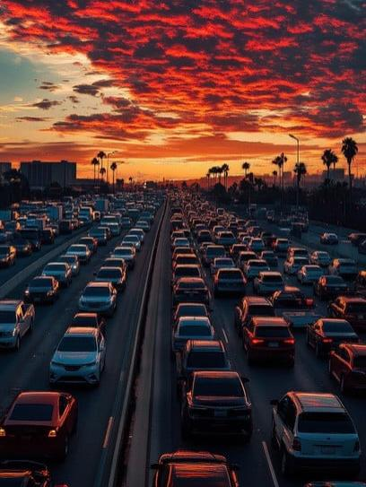
What is traffic?
Traffic refers to the movement of vehicles, people, or goods along roads or pathways. It includes cars, buses, bikes, and pedestrians traveling from one place to another. Proper traffic flow is important to avoid congestion and ensure safety.

Slide 8
How traffic harms us &
Affects our daily life?
Traffic problems affects our lives in various ways –
1. It wastes our travel time .
2. It wastes fuels and our energy .
3. It makes us feel depressed and creates emotional trauma.
4. It leads to too much honking of horns and creates sound pollution
5. It creates a global threat as it damages our air and damages the balance of our ecosystem .
6. Results in increased in death rates of the people , as it can be a threat in case of any emergency.

Slide 9
What we want to solve?
We want to reduce heavy traffic congestion on busy roads.
We aim to save time and make travel smoother for people.
We want to lower fuel wastage and pollution caused by traffic jams.
We aim to improve road safety and overall transportation efficiency.
We want to monitor the physical and mental state of the people and to reduce their stress level

Slide 10

About our Website
1. It will help to connect with the mobiles and smart watches of the people and maintain their heart rate and their stress level .
2. In case of over speeding it would help to give notification to the police and to the family members and will make the driver more responsible
3. Our website also would help to contact to the police , recovery vehicles and the Ambulance for instant
4. Our website would making focus to control the stress and the physical health of the people .
5. This website system is works with government that it can work on a very large scale then it can save the lives of millions of the people .

Slide 11
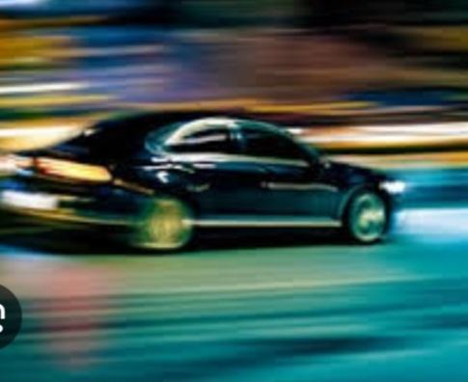
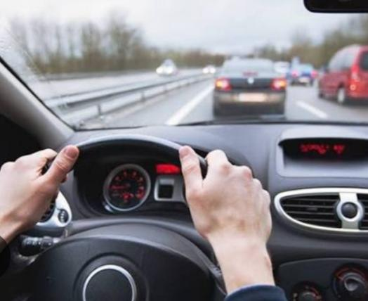
How it will help and work
1. The website tracks heart rate and stress levels through mobile and smart watches.
2. It alerts the driver if stress is high to prevent unsafe driving.
3. If over speeding occurs, it sends notifications to police and family members.
4. In emergencies, it automatically contacts ambulance, police, and recovery vehicles.
5. If it collabs with the government then it can work on a large scale to save many lives.

Slide 12
Who will it help?
1. Drivers – by improving health awareness and preventing accidents , constant monitoring would make them more responsible .
2. Families – by keeping them informed and ensuring their loved ones are safe.
3. Government & Traffic Authorities – by reducing accidents and improving road safety management.

Slide 13
Impact in a long run
1. Reduction in Road Accidents: With real-time monitoring and emergency alerts, the number of accidents will decrease significantly, making roads safer.
2. Improved Public Health: Continuous stress and heart-rate monitoring will encourage healthier driving habits and reduce health-related driving risks.
3. Stronger Safety Network: Quick coordination between police, ambulances, and recovery vehicles will create a more efficient emergency response system.
4. Safer and More Responsible Driving Culture: Over time, drivers will become more cautious and responsible, leading to a disciplined traffic environment and fewer traffic violations.

Slide 14
Stability and Scalability
Note:- WE HAVE CURRENTLY MADE OUR WEBSITE ON A SMALLER SCALE .
1. Works smoothly even with high user traffic.
2. Uses secure and reliable cloud servers.
3. Can be updated easily without service interruption.
4. Supports integration with multiple devices (phones, watches, vehicles).
5. Can connect with government traffic systems on a large scale.
6. Handles real-time data processing efficiently.
7. Flexible to add new features in future.
8. Can expand to different regions with minor setup changes.

Slide 15
Things we could fulfil &
Things we couldn’t fulfil
Things which we could not do –
We were unable to get the API of Google maps so we have linked it with open Street maps , but it won’t affect the main purpose .
2. Unfortunately, we were not able to make a speed tracker because for that we will have to make another device .
3. We were not able to maintain the health record , because normal smart watches are capable of doing that .
Sorry for inconveniences
Things we could do:-
We are able to attach the Open Street map , as a result we can track the traffic and the current location of our users
Now the people can call for help with just a click .
We can ensure more safety and since the traffic can be seen so it is easy for the traffic police to control the traffic .

Slide 16
Trail and Errors
We tried to get the API from Google maps but we were unable to do that so we had to take the API from open Street maps .
We have tried our level best to make maximum things success but out of our 5 main goals we are able to make success on 3 goals .
Now if the webpage is a success that it can help all the people and make our lives more smooth and quick .
Working on a larger scale it can save fuels , time , money , wealth and health of the people

Slide 17
Conclusion
In conclusion, this website provides a smart and efficient solution to improve road safety and health awareness among drivers. By monitoring stress, heart rate, and driving behavior, it helps prevent accidents before they happen and ensures quick support in emergencies. With the ability to connect to police, ambulance services, and government systems, it can operate on a large scale and make transportation safer for everyone. Over time, this technology can help build a more responsible driving culture and save countless lives.

Slide 18


